Slide 1
Ensemble learning
Ali Madani
Farnoosh Khodakarami

Slide 2
Ensemble learning (concept)
Marie Jean Antoine Nicolas de Caritat
(French mathematician; 1743–1794)
Condorcet’s jury theorem in 1785:
Each voter has a probability p > .5 of being correct (better than a random guess)
adding more voters increases the probability of making the correct decision

Slide 3
Ensemble learning methods
Majority
Averaging
Weighted Average
Stacking
Bagging
Boosting

Slide 4
Majority (for classification)
Vote
Voter 1
(model 1)
Majority vote
Ensemble vote
Voter 2
(model 2)
Voter 3
(model 3)
Voter 4
(model 4)

Slide 5
Averaging (for regression or calculating class probabilities in classification)
Predicted value
model 1
1
Averaging
Ensemble prediction
model 2
2
(1+2+2+1)/4=1.5
model 3
2
model 4
1

Slide 6
Weighted Average
Predicted value
Weight
model 1
1
0.1
Weighted average
Ensemble prediction
model 2
2
0.25
1*0.1+2*0.25+
2*0.35+1*0.3
=1.6
model 3
2
0.35
model 4
1
0.3
Total = 1

Slide 7
Stacking
Predicted value for datapoint i
model 1
Pi1
Second
level model
model 2
Ensemble prediction
Pi2
PiE
model 3
Pi3
model 4
Pi4

Slide 8
Bagging (Bootstrap Aggregating)
Training
Subset 1
model 1
Subset 2
model 2
Bootstrapping
Ensemble prediction
Subset 3
model 3
(sampling with replacement)
Subset 4
model 4

Slide 9
Boosting (sequential model correction)
Training
model 1
Weights of models are different depending on their performance
model 2
Ensemble prediction
model 3
model 4

Slide 10
Bagging and boosting algorithms
Bagging algorithms
Boosting algorithms
Random forest
Adaboost
Gradient Boosting Method (GBM)

Slide 11
Decision Trees and Random Forest

Slide 12
Individual decision tree for classification
Feature i
(kid?)
yes
no
Class 1
Class 2

Slide 13
Individual decision tree for classification
Feature i
(kid?)
Feature j
yes
no
Category 1
Category 2
Class 1
Class 2
Class 1
Class 2

Slide 14
Individual decision tree for classification
Feature i
(kid?)
Feature j
yes
no
kid
adult
Class 1
Class 2
Class 1
Class 2

Slide 15
Individual decision tree for classification
Feature i
Feature j
Feature j
yes
no
kid
adult
<= threshold
> threshold
Class 1
Class 2
Class 1
Class 2
Class 1
Class 2

Slide 16
Individual decision tree for classification
Feature i
Feature j
Feature j
(Age)
yes
no
kid
adult
<= 12
> 12
Class 1
Class 2
Class 1
Class 2
Class 1
Class 2

Slide 17
Depth of decision tree
Feature i
Feature k
Feature j
Feature t
Feature z
Feature m
Feature p
Feature s
Feature t
Feature q
Feature b

Slide 18
Terminologies: root
Feature i
Decision maker only
Feature k
Feature j
Feature t
Feature z
Feature m
Feature p
Feature s
Feature t
Feature q
Feature b

Slide 19
Terminologies:
internal nodes
Feature i
Decision maker
Decision receiver
Feature k
Feature j
Feature t
Feature z
Feature m
Feature p
Feature s
Feature t
Feature q
Feature b

Slide 20
Terminologies:
leaves
Feature i
Decision receiver only
Feature k
Feature j
Feature t
Feature z
Feature m
Feature p
Feature s
Feature t
Feature q
Feature b

Slide 21
The difference between the groups are not known yet
Feature i
?
?

Slide 22
Data points within each group determines the identities of the groups
Feature i
?
?

Slide 23
Data points within each group determines the identities of the groups
Feature i
Class 1
Class 2

Slide 24
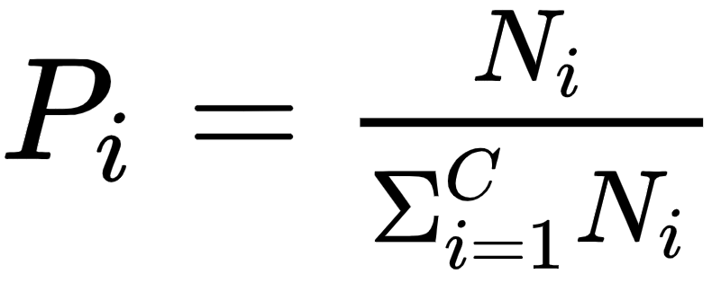
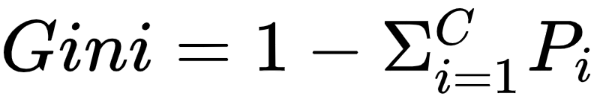
It is better to not have mixed identities (classes)
Feature i
Let’s assess impurity of the classes:
C: total number of classes
Class 1
Class 2

Slide 25
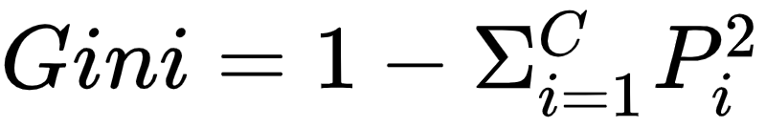
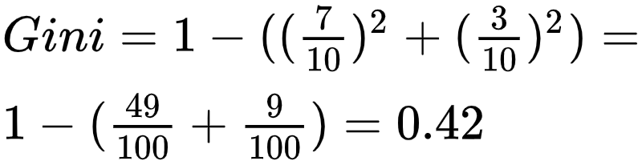
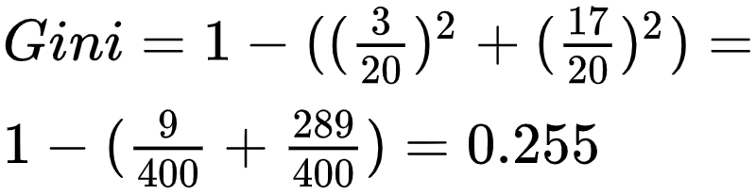
Calculating impurity (Gini) for each leaf
Feature i
Let’s assess impurity of the classes:
C: total number of classes
Class 1
Class 2

Slide 26
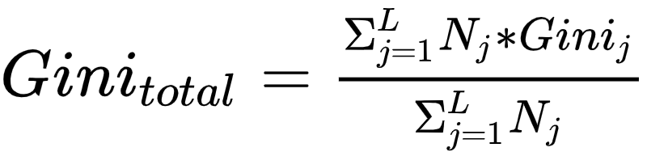

Total impurity as the weighted average of leaf impurities
Feature i
Class 1
Class 2

Slide 27

Entropy as another measure for impurity assessment
Feature i
C: total number of classes
Class 1
Class 2

Slide 28
Assigning features as nodes using impurity
It is better to have shallower trees
Choosing the feature with the lowest Gini as the root
Then choosing the next features with the lowest Gini for the next internal node
....

Slide 29
Combining decision trees to build random forests
Features of sample i
Decision tree 1
Decision tree 2
Decision tree 3
Decision tree M
1 decision tree has high variance

Slide 30
Combining decision trees to build random forests
Features of sample i
Decision tree 1
Decision tree 2
Decision tree 3
Decision tree M
Class 1
Class 1
Class 1
Class 1

Slide 31
Combining decision trees to build random forests
Features of sample i
Random forest
Class 1

Slide 32
Dataset for building a random forest model for
ID | Feature 1 | Feature 2 | Feature 3 | ... | Feature M | Class
1 |  |  |  |  |  | 1
2 |  |  |  |  |  | 1
3 |  |  |  |  |  | 2
4 |  |  |  |  |  | 1
 |  |  |  |  |  | . . .
N-1 |  |  |  |  |  | 2
N |  |  |  |  |  | 1

Slide 33
Bootstrapping (sampling with replacement)
ID | Feature 1 | Feature 2 | Feature 3 | ... | Feature M | Class
1 |  |  |  |  |  | 1
2 |  |  |  |  |  | 1
3 |  |  |  |  |  | 2
4 |  |  |  |  |  | 1
 |  |  |  |  |  | . . .
N-1 |  |  |  |  |  | 2
N |  |  |  |  |  | 1
Randomly selecting data points (IDs)

Slide 34
Random variable selection for identifying an optimal random forest
ID | Feature 1 | Feature 2 | Feature 3 | ... | Feature M | Class
1 |  |  |  |  |  | 1
2 |  |  |  |  |  | 1
3 |  |  |  |  |  | 2
4 |  |  |  |  |  | 1
 |  |  |  |  |  | . . .
N-1 |  |  |  |  |  | 2
N |  |  |  |  |  | 1
Randomly selecting columns (features) for building decision trees

Slide 35
Steps of building random forests
Bootstrapping (random sampling of data points with replacement)
Randomly selecting the features to build the decision tree
Repeat steps (1) and (2) to build multiple decision tree
Use majority vote of all the decision trees as the identified class for a given data point

Slide 36
Adaboost

Slide 37
Important features of modeling using Adaboost
Feature i
Using stumps
Tree with only one node and two leaves
Stumps are weak classifiers
Stumps are built in a sequential manner not in parallel
Performance of one stump determines how the next stump is built
Stumps have different voting weights
?
?
This is a stump

Slide 38
Steps of building an Adaboost model
Consider same weight for all datapoints (normalized to add up to 1)
Making stumps with all individual features

Slide 39
Steps of building an Adaboost model
Consider same weight for all datapoints (normalized to add up to 1)

Slide 40
Steps of building an Adaboost model
Consider same weight for all datapoints (normalized to add up to 1)
Making stumps with all individual features
Calculate Gini index for each stump

Slide 41
Steps of building an Adaboost model
Consider same weight for all datapoints (normalized to add up to 1)
Making stumps with all individual features
Calculate Gini index for each stump
Order the stumps based on their Gini indices

Slide 42
Steps of building an Adaboost model
Consider same weight for all datapoints (normalized to add up to 1)
Making stumps with all individual features
Calculate Gini index for each stump
Order the stumps based on their Gini indices
Select the best stump

Slide 43
Steps of building an Adaboost model
Consider same weight for all datapoints (normalized to add up to 1)
Making stumps with all individual features
Calculate Gini index for each stump
Order the stumps based on their Gini indices
Select the best stump
Calculate error of the selected stump as the sum of the weights of incorrectly classified samples

Slide 44
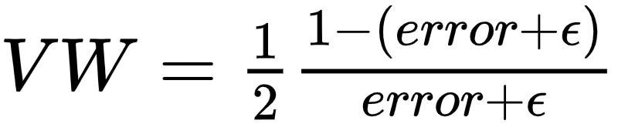
Steps of building an Adaboost model
Consider same weight for all datapoints (normalized to add up to 1)
Making stumps with all individual features
Calculate Gini index for each stump
Order the stumps based on their Gini indices
Select the best stump
Calculate error of the selected stump as the sum of the weights of incorrectly classified samples
Calculating voting weight of the selected stump

Slide 45

Steps of building an Adaboost model
Consider same weight for all datapoints (normalized to add up to 1)
Making stumps with all individual features
Calculate Gini index for each stump
Order the stumps based on their Gini indices
Select the best stump
Calculate error of the selected stump as the sum of the weights of incorrectly classified samples
Calculating voting weight of the selected stump
Increasing weights of incorrectly classified datapoints

Slide 46

Steps of building an Adaboost model
Consider same weight for all datapoints (normalized to add up to 1)
Making stumps with all individual features
Calculate Gini index for each stump
Order the stumps based on their Gini indices
Select the best stump
Calculate error of the selected stump as the sum of the weights of incorrectly classified samples
Calculating voting weight of the selected stump
Increasing weights of incorrectly classified datapoints
Decreasing weights of correctly classified datapoints

Slide 47
Steps of building an Adaboost model
Consider same weight for all datapoints (normalized to add up to 1)
Making stumps with all individual features
Calculate Gini index for each stump
Order the stumps based on their Gini indices
Select the best stump
Calculate error of the selected stump as the sum of the weights of incorrectly classified samples
Calculating voting weight of the selected stump
Increasing weights of incorrectly classified datapoints
Decreasing weights of correctly classified datapoints
Normalize the weights to add up to 1
Repeat steps 2 to 10 using the new sample weights

Slide 48
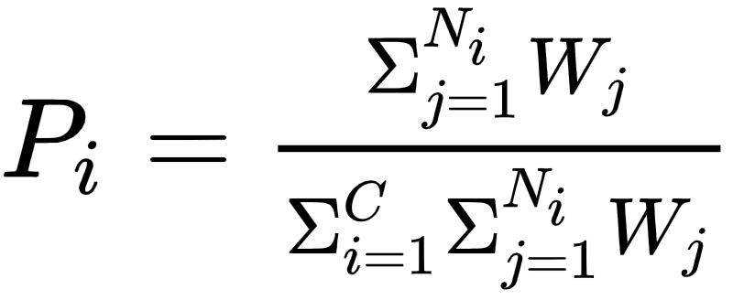
How to calculate weighted Gini index
Feature i
Let’s assess impurity of the classes:
C: total number of classes
Class 1
Class 2

Slide 49
Gradient Boosting Method (GBM)

Slide 50
Important features of Gradient Boosting
Gradient Boosting Method (GBM) is used for continuous value prediction
Technically it is a regression model by default
Although it is a regression model, it can be used for classification
It starts by a single leaf (as the initial guess of all samples), then a tree is built
Similar to Adaboost, a tree is built relying on the error of the previous tree
Although the tree size is restricted, it is not necessarily a stump (like in Adaboost)
GBM scales the trees by the same amount
GBM continues building trees up until
Specific number of trees, that we determined
Or additional trees does not improve the model

Slide 51
Extra useful information

Slide 52
Useful links
Installation instructions
scikit-learn
Anaconda distribution of Python
IPython
Data Sets
scikit-learn DataSet
scikit-learn: machine learning in Python :
https://scikit-learn.org/stable/
Useful cheat sheets:
https://www.analyticsvidhya.com/blog/2017/02/top-28-cheat-sheets-for-machine-learning-data-science-probability-sql-big-data/

Slide 53


Slide 54
Thanks

